Slide 1
Sostenibilidad Software: ¿realidad o quimera?
Coral Calero
Grupo Alarcos
Escuela Superior de Informática
Universidad de Castilla-La Mancha
La Laguna, Noviembre 2018

Slide 2
Agenda

Slide 3

Introduction to Software Sustainability

Slide 4
Introduction to Software Sustainability
Sustainable development is the ability to meet the needs of the present without compromising the ability of future generations to satisfy their own needs
UN Brutland Report, 1987
Notes:
several definitions of sustainability can be found in literature:
• The Collins dictionary [2], defines Sustainability as “the ability to be maintained at a steady level without exhausting natural resources or causing severe ecological damage”.
• A similar definition of ‘sustainable’ can be found in the Merriam-Webster dictionary: “of, relating to, or being a method of harvesting or using a resource so that the resource is not depleted or permanently damaged” [3].
• According to [4], a sustainable world is broadly defined as “one in which humans can survive without jeopardizing the continued survival of future generations of humans in a healthy environment"
• In [5], the authors state that “sustainability can be discussed with reference to a concrete system (ecological system, a specific software system, etc.), therefore, global sustainability implies the capacity for endurance given the functioning of all these systems in concert”.
• “Sustainability is the capacity to endure and, for humans, the potential for long-term maintenance” [6].
• From another perspective, Sustainability can be viewed as “one more central quality attribute in a row with the standard quality attributes of correctness, efficiency, and so forth” [6]. These same authors also defined the term Sustainable development as being that which “includes the aspect to develop a sustainable product, as well as the aspect to develop a product using a sustainable development process”.
• The United Nations (UN)’ Brundtland report defines sustainable development as the ability to “meet the needs of the present without compromising the ability of future generations to satisfy their own needs” [7]. According to the UN, sustainable development needs to satisfy the requirements of three dimensions, which are society, the economy, and the environment.
• In [8], the author identifies the same dimensions as those defined in the aforementioned UN report for sustainable development: economic development, social development and environmental protection:
o “Environmental sustainability ensures that the environment is able to replenish itself at a faster rate than it is destroyed by human actions. For instance, the use of recycled material for IT Hardware production helps to conserve natural resources
o Social development is concerned about creating a sustainable society which includes social justice or reducing poverty. In general all actions that promote social equity and ethical consumerism and
o The economic pillar ensures that our economic growth maintains a healthy balance with our ecosystem; it integrates environmental and social concerns into business”.
Of all the definitions shown above, the most widely-used is that established by the United Nations (UN)’ Brundtland report [7].

Slide 5
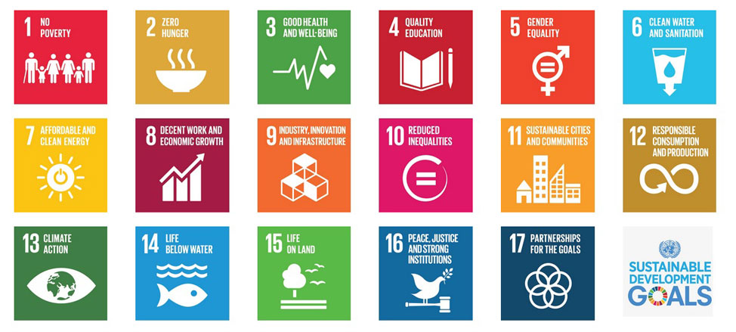

Introduction to Software Sustainability
Notes:
Sustainability is demanded by present-day society; we have become aware of the need to cut down on our energy consumption and reduce our carbon footprint

Slide 6
Introduction to Software Sustainability
Software delivers a total value-added of €910 billion (>7% of the EU28 total GDP)
Software generates 3.1 million of direct jobs (1.4% of total EU jobs)
Software companies are one kind of organization that develop software for others by following engineering practices.
Software companies in the EU invest strongly in software R&D (12.7 billion € in 2013)
BSA, 2017) Software: A €910 billion catalyst for the EU Economy. Nov. 2016. http://softwareimpact.bsa.org/eu/pdf/EU_Economic_Impact_of_Software_Report_en.pdf
Notes:
Gross domestic product

Slide 7

Introduction to Software Sustainability
2167 million of active users in a month in Facebook
320 million of active users in a month in Twitter
1500 million of active users in a month in Youtube
2000 million of active users in Google (Maps, Chrome, Gmail, Busquedas, Play)
7.550 million of people.

Slide 8
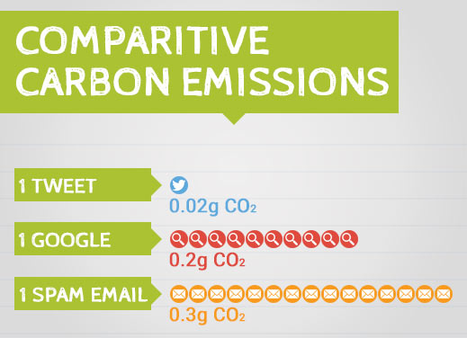
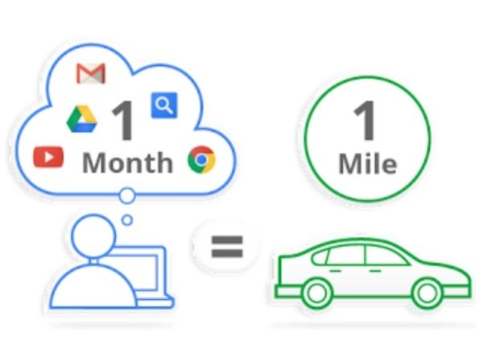
Introduction to Software Sustainability

Slide 9
Introduction to Software Sustainability
Around 2% of the CO2 worldwide emissions in 2018
TIC market
Around 3-4% in 2020 (two times the emissions of United Kingdom)

Slide 10
Introduction to Software Sustainability
While sustainability is a standardized practice in a number of engineering disciplines, is not the case within the software engineering community (Penzenstadler et al, 2012)
But we need to be conscious that, besides the advantages of the software systems, they need a great amount of energy to work.
Notes:
Prodcuto interior bruto
Growth DP

Slide 11
Introduction to Software Sustainability
Sustainable Software is software, whose direct and indirect negative impacts on economy, society, human beings, and environment that result from development, deployment, and usage of the software are minimal and/or which have a positive effect on sustainable development. (Dick et al., 2010)

Slide 12
Introduction to Software Sustainability
Notes:
several definitions of sustainability can be found in literature:
• The Collins dictionary [2], defines Sustainability as “the ability to be maintained at a steady level without exhausting natural resources or causing severe ecological damage”.
• A similar definition of ‘sustainable’ can be found in the Merriam-Webster dictionary: “of, relating to, or being a method of harvesting or using a resource so that the resource is not depleted or permanently damaged” [3].
• According to [4], a sustainable world is broadly defined as “one in which humans can survive without jeopardizing the continued survival of future generations of humans in a healthy environment"
• In [5], the authors state that “sustainability can be discussed with reference to a concrete system (ecological system, a specific software system, etc.), therefore, global sustainability implies the capacity for endurance given the functioning of all these systems in concert”.
• “Sustainability is the capacity to endure and, for humans, the potential for long-term maintenance” [6].
• From another perspective, Sustainability can be viewed as “one more central quality attribute in a row with the standard quality attributes of correctness, efficiency, and so forth” [6]. These same authors also defined the term Sustainable development as being that which “includes the aspect to develop a sustainable product, as well as the aspect to develop a product using a sustainable development process”.
• The United Nations (UN)’ Brundtland report defines sustainable development as the ability to “meet the needs of the present without compromising the ability of future generations to satisfy their own needs” [7]. According to the UN, sustainable development needs to satisfy the requirements of three dimensions, which are society, the economy, and the environment.
• In [8], the author identifies the same dimensions as those defined in the aforementioned UN report for sustainable development: economic development, social development and environmental protection:
o “Environmental sustainability ensures that the environment is able to replenish itself at a faster rate than it is destroyed by human actions. For instance, the use of recycled material for IT Hardware production helps to conserve natural resources
o Social development is concerned about creating a sustainable society which includes social justice or reducing poverty. In general all actions that promote social equity and ethical consumerism and
o The economic pillar ensures that our economic growth maintains a healthy balance with our ecosystem; it integrates environmental and social concerns into business”.
Of all the definitions shown above, the most widely-used is that established by the United Nations (UN)’ Brundtland report [7].

Slide 13
Introduction to Software Sustainability

Slide 14
Introduction to Software Sustainability
Hay que asegurar las ganancias de las empresas que desarrollan software sin que eso suponga sueldos no justos
Las versiones de las aplicaciones deben mantener unos niveles de uso de energía adecuados
Las empresas proporcionan programas de formación y promoción adecuados a sus trabajadores
El software del robot que limpia las malas hierbas de las plantaciones usando solo un 5% del herbicida habitual, aplicando los productos sólo dónde es necesario

Slide 15


When and What of Software Sustainability Research
Notes:
In this section, Fig. 7 will be used as a basis to show a snapshot of what the software sustainability measurement currently looks like. As an example, we shall present some measures and/or indicators defined for each of the levels shown in Fig. 7 (when possible). In some cases, we shall also provide some useful references that include revisions of the literature and can be used as a good point of start.

Slide 16
When and What of Software Sustainability Research
When did the software sustainability research start?

Slide 17
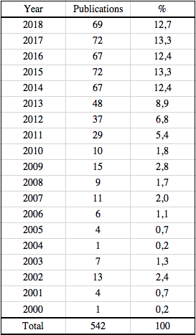
When and What of Software Sustainability Research
GREENSOFT model (Naumann et al)
Notes:
We have characterized the research literature in green and sustainable software by means of a bibliometric study
At the beginning of August 2017
Papers between 2000 and 2017
From the computer science category of SCOPUS
Written in English

Slide 18
When and What of Software Sustainability Research
Notes:
The least squares method was used as a basis to perform a trend analysis so as to estimate the number of publications that may appear in the future. A straight line was calculated using the data concerning the last decade (from 2007 to 2016), resulting in the Equation 5:
$Y=\frac{1327}{330}X+ \frac{365}{10}$ (5)
where Y is the estimated number of publications each year and X is an input of the equation conveniently selected. In order to make it easier to attain the coefficients, the X values are selected to obtain zero when all their values are added up.
Table 6 shows the publication trend calculated. As can be seen, the estimation indicates that, each year, 8 additional publications will be produced in comparison with the previous year.

Slide 19
When and What of Software Sustainability Research
What did the results of this research be?

Slide 20

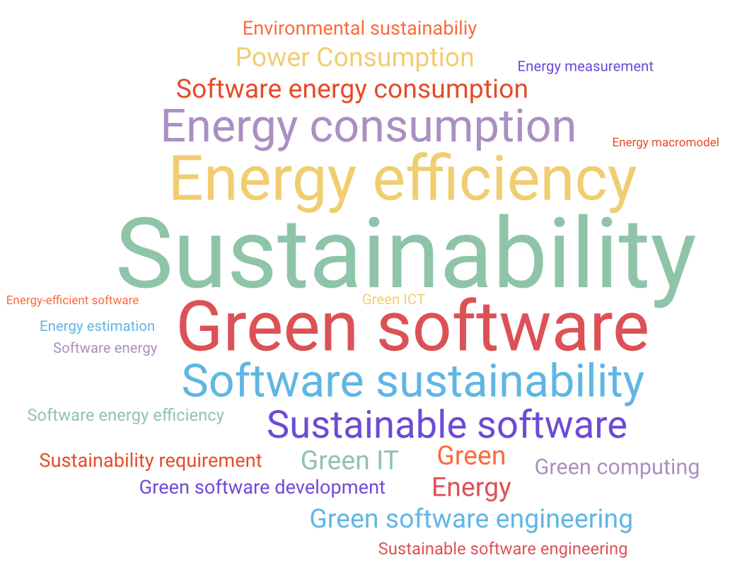
When and What of Software Sustainability Research
Authors Keywords
(>20 occurrences)
Green Software
Green IT
Sustainability
Software Sustainability Sustainable Software Energy Consumption Energy Efficiency
VOSViewer Keywords (>20 occurrences)
Notes:
Table 17 shows those keywords related to green and sustainable software with more than 20 occurrences in the selected papers recovered by using VOSViewer. Table 18 shows the same information, but using the keywords provided by authors as a basis. Figures 4 and 5 show the same information by means of a keyword cloud.

Slide 21
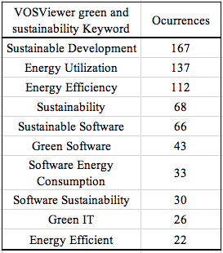
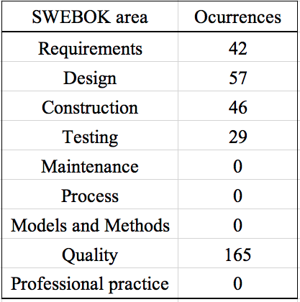
When and What of Software Sustainability Research
Notes:
In order to have another perspective about the works on green and software sustainability, we have classified the VOSViewer domains shown in Table 19 into SWEBOK (IEEE, 2014). SWEBOK includes 15 areas related to software engineering, we have used neither the foundations areas nor the management areas because they are too general to be useful for classification purposes.
Table 21 shows the classification. It is necessary to clarify that we have considered “Computer software selection and evaluation” as Professional Practice”, “Optimization” as “Quality” and “Software Architecture” as “Design”. From this table we can conclude that the 35% of occurrences are domains related to one of the SWEBOK areas. If we add to this figure the 119 ocurrences of the generic domain “Software engineering” this percentage increases up to 59,75%. So, most than the half of the works have SWEBOK related keywords. On the opposite, there are four SWEBOK areas without contributions: construction, maintenance, process and models&methods.

Slide 22
What about Software Sustainability in industry?
Notes:
In this section, Fig. 7 will be used as a basis to show a snapshot of what the software sustainability measurement currently looks like. As an example, we shall present some measures and/or indicators defined for each of the levels shown in Fig. 7 (when possible). In some cases, we shall also provide some useful references that include revisions of the literature and can be used as a good point of start.

Slide 23
What about Software Sustainability in industry?
?
Sustainable Software
€
=

Slide 24

What about Software Sustainability in industry?
Sustainable Software
CSR
PART OF THE BUSINESS OBJECTIVES

Slide 25
What about Software Sustainability in industry?
Corporate Social Responsibility (CSR) involves the voluntary integration by companies of social and environmental concerns in their business operations and relationships with their partners
Notes:
There is the need for socially responsible values to exist, which are to some extent shared by consumers, investors, employees and other social actors, and considered in their decision making. Firms with a good reputation for social responsibility may improve relationships with external actors such as customers, investors, bankers, suppliers and competitors. They may also attract better employees or increase current employees’ motivation and morale in addition to their commitment and loyalty to the firm, which may in turn improve financial outcomes.

Slide 26
What about Software Sustainability in industry?
Notes:
Benefits of CSR for organizations. Investments in socially responsible activities may have internal benefits in the form of helping a firm to develop new resources and capabilities which are related namely to know-how and corporate culture. The external benefits of CSR are related to its effect on corporate reputation. The present-day dominant conception of CSR implies that firms voluntarily integrate social and environmental concerns in their operations and interactions with stakeholders (Castelo and Lima, 2006).
These business benefits of CSR can be classified into monetary and non-monetary benefits. Monetary benefits include direct financial effects and those indirect benefits that result in cash flows which cannot, however, be understood in monetary terms (e.g., an increase in the value of the brand). Engaging in socially responsible activities involves costs. The investments required may not have an immediate pay-off. In fact, whereas the costs involved are usually short-term in nature or are continuous outflows, the benefits are often long-term (Castelo and Lima, 2006).
Non-monetary benefits refer to benefits that are not considered directly in monetary terms, but which nevertheless influence the company’s competitiveness and its financial success (e.g., changes in the prices of the repurchase or a positive change in customers’ attitudes). The business benefits of CSR can therefore be systematized into five major areas: Positive effects on the company’s image and reputation, positive effects on motivation, retention and recruitment of staff, saving costs, growth of revenue from high sales and market share and risk reduction related to CSR.

Slide 27
What about Software Sustainability in industry?
CSR dimensions
CSR
Voluntariness
Environmental
Economic
Social
Stakeholders

Slide 28
What about Software Sustainability in industry?
increase profits increase profits increase profits increase profits
Consumers want and expect attributes from what they buy - quality, safety,...
Employees want more than a paycheck.
Communities want a good corporate citizen, provide employees with a living wage, not pollute, to pay its fair share of taxes, support the community, …
Notes:
In the 70s: one social responsibility of business, to increase its profits.
Today people expect (and demand):
Consumers want and expect attributes from what they buy - quality, safety, value.
Employees want more than a paycheck.
Communities want the company:
to be a good corporate citizen and hire from the community
provide employees with a living wage
not pollute
to pay its fair share of taxes
support the community

Slide 29
What about Software Sustainability in industry?
Top 10 companies deriving revenue from software
(Seth, 2017)
Ten largest tech companies in Stoller (2017)
Notes:
The company sells software through the software-as-a-service model.
We have studied companies that develop software trying to know if they are aligned with software sustainability.
To do that, we have studied the CSR of the ten biggest software companies identifying if they are considering software sustainability aspects.

Slide 30
What about Software Sustainability in industry?
Corporate Social Responsibility
Software Sustainability dimensions
Human
Economic
Other actions
Green IN Sw
Green BY Sw
Green Hw
Notes:
percentage of actions which are directly related to some of the sustainability dimensions. As we previously mentioned, the sustainability dimensions are: human, economic and environmental. In the environmental dimension, we distinguish between green hardware and green software. In addition, the green software dimension is divided into green in software and green by software.

Slide 31
What about Software Sustainability in industry?
Notes:
percentage of actions which are directly related to some of the sustainability dimensions. As we previously mentioned, the sustainability dimensions are: human, economic and environmental. In the environmental dimension, we distinguish between green hardware and green software. In addition, the green software dimension is divided into green in software and green by software.

Slide 32
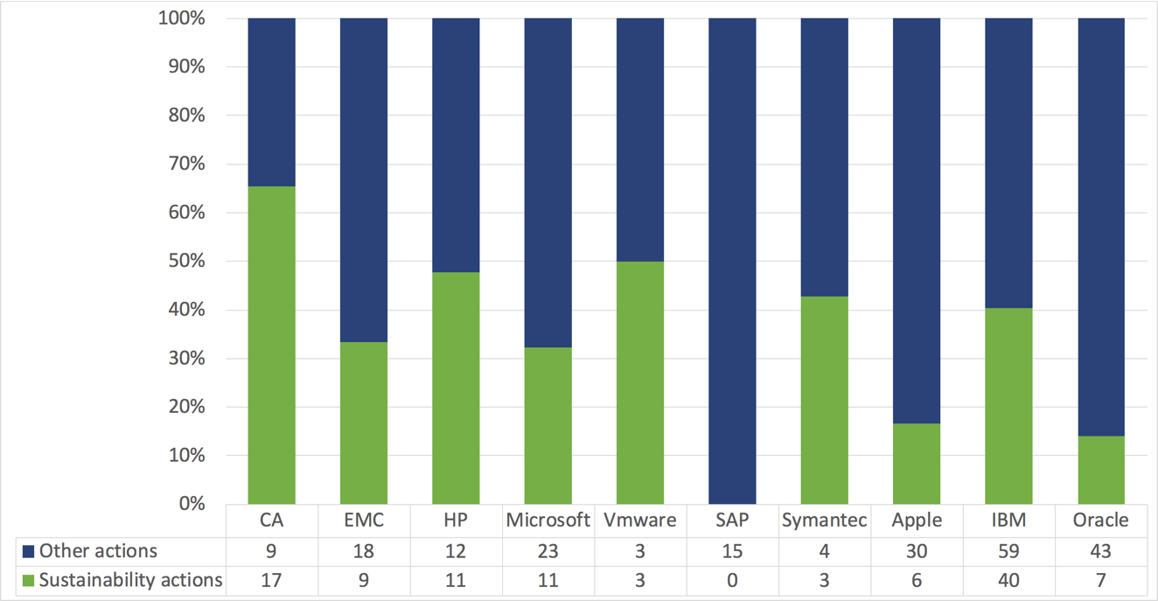
What about Software Sustainability in industry?
Notes:
percentage of actions which are directly related to some of the sustainability dimensions. As we previously mentioned, the sustainability dimensions are: human, economic and environmental. In the environmental dimension, we distinguish between green hardware and green software. In addition, the green software dimension is divided into green in software and green by software.

Slide 33
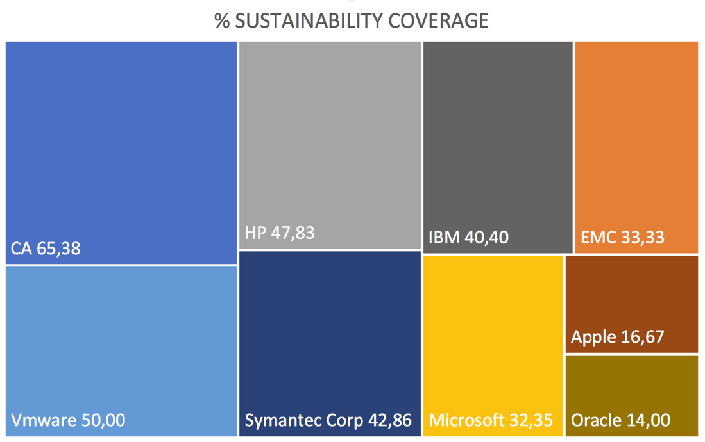
What about Software Sustainability in industry?
Notes:
percentage of actions which are directly related to some of the sustainability dimensions. As we previously mentioned, the sustainability dimensions are: human, economic and environmental. In the environmental dimension, we distinguish between green hardware and green software. In addition, the green software dimension is divided into green in software and green by software.

Slide 34
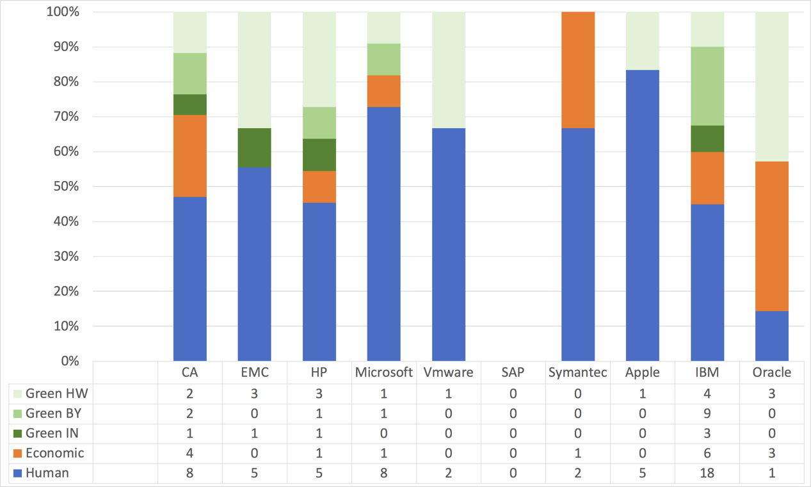
What about Software Sustainability in industry?
Notes:
percentage of actions which are directly related to some of the sustainability dimensions. As we previously mentioned, the sustainability dimensions are: human, economic and environmental. In the environmental dimension, we distinguish between green hardware and green software. In addition, the green software dimension is divided into green in software and green by software.

Slide 35
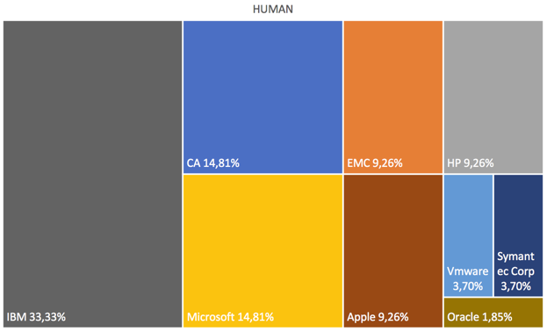
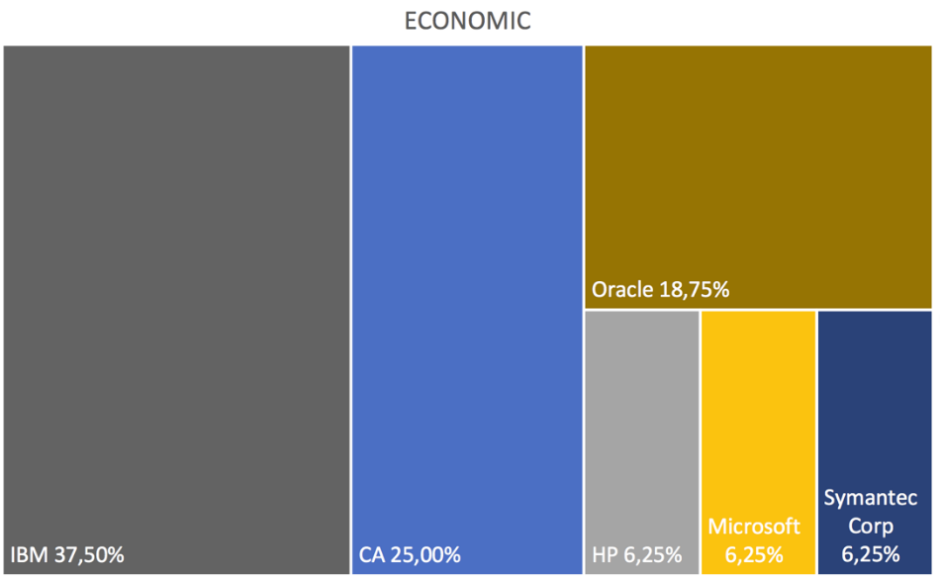
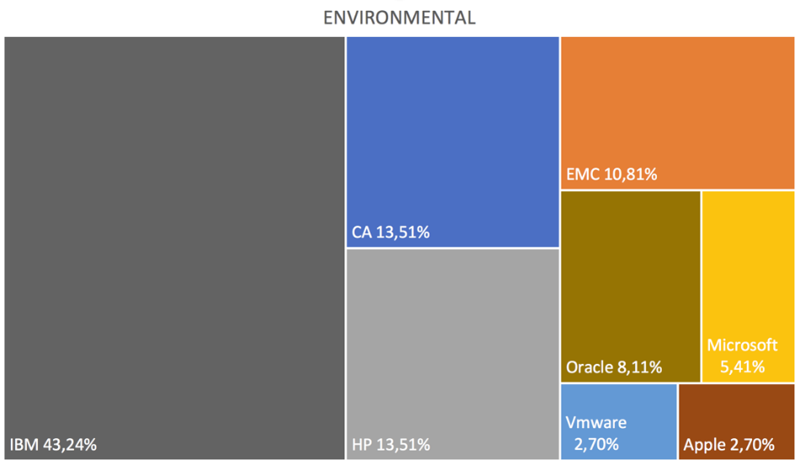
What about Software Sustainability in industry?
Notes:
percentage of actions which are directly related to some of the sustainability dimensions. As we previously mentioned, the sustainability dimensions are: human, economic and environmental. In the environmental dimension, we distinguish between green hardware and green software. In addition, the green software dimension is divided into green in software and green by software.

Slide 36
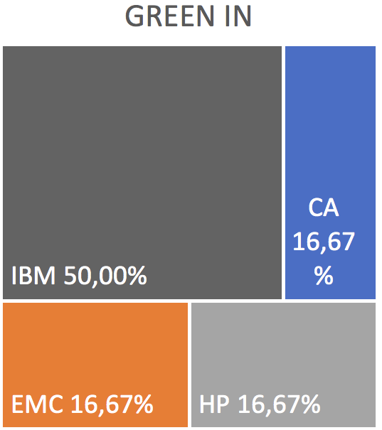
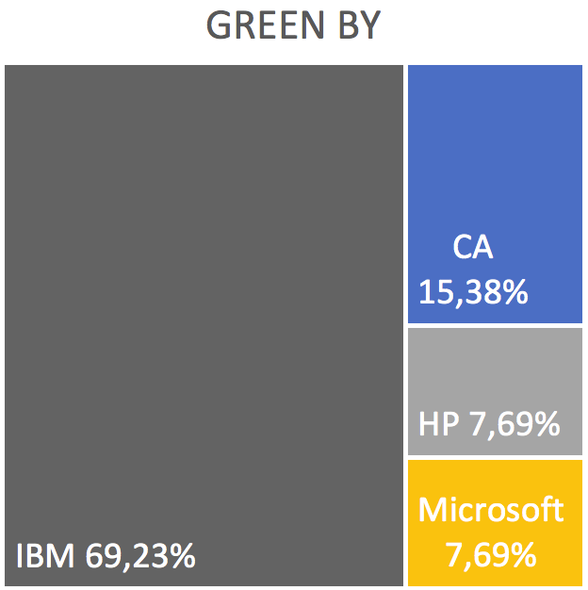
What about Software Sustainability in industry?
Notes:
percentage of actions which are directly related to some of the sustainability dimensions. As we previously mentioned, the sustainability dimensions are: human, economic and environmental. In the environmental dimension, we distinguish between green hardware and green software. In addition, the green software dimension is divided into green in software and green by software.

Slide 37
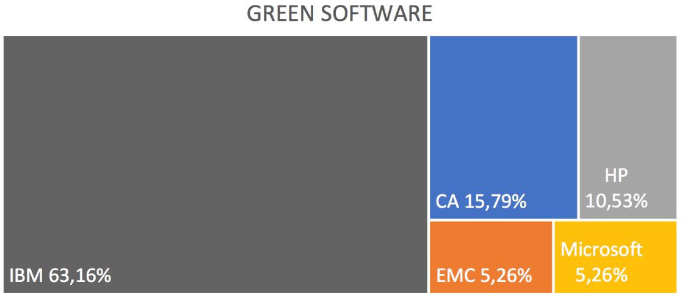
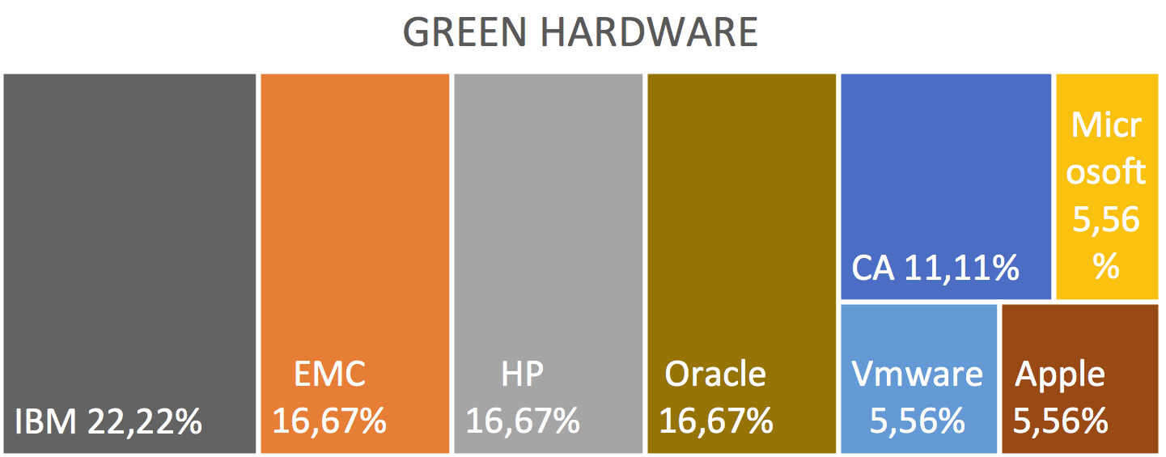
What about Software Sustainability in industry?
Notes:
percentage of actions which are directly related to some of the sustainability dimensions. As we previously mentioned, the sustainability dimensions are: human, economic and environmental. In the environmental dimension, we distinguish between green hardware and green software. In addition, the green software dimension is divided into green in software and green by software.

Slide 38
What about Software Sustainability in industry?
Notes:
percentage of actions which are directly related to some of the sustainability dimensions. As we previously mentioned, the sustainability dimensions are: human, economic and environmental. In the environmental dimension, we distinguish between green hardware and green software. In addition, the green software dimension is divided into green in software and green by software.

Slide 39
GINSENG (Green in Software Systems and Software Engineering)
Notes:
In this section, Fig. 7 will be used as a basis to show a snapshot of what the software sustainability measurement currently looks like. As an example, we shall present some measures and/or indicators defined for each of the levels shown in Fig. 7 (when possible). In some cases, we shall also provide some useful references that include revisions of the literature and can be used as a good point of start.

Slide 40
GINSENG
Entorno de gobierno para el desarrollo de software Green
Medición e interacción de greenability en la calidad
Gabriel A. García-Mireles. Univ. Sonora
Procesos Software Green. Green BPM
Prof. Anaisa Hernández. CUJAE
FEETINGS
Incluir objetivos de sostenibilidad desde la fase de IR
Prof. Ambrosio Toval. Universidad de Murcia
Evaluar la eficiencia energética de las pruebas de software Prof. Martha Dunia Delgado. CUJAE

Slide 41
FEETINGS (Framework for Energy Efficiency Testing to Improve eNviromental Goals of the Software)
Notes:
In this section, Fig. 7 will be used as a basis to show a snapshot of what the software sustainability measurement currently looks like. As an example, we shall present some measures and/or indicators defined for each of the levels shown in Fig. 7 (when possible). In some cases, we shall also provide some useful references that include revisions of the literature and can be used as a good point of start.

Slide 42
FEETINGS
SEA (Software Energy Assessment).
Processes analyses and supports a suitable visualization of the results
Energy Efficiency Tester (EET), hardware device to collect the consumption data of the evaluated software
Notes:
The final goal is to use the measurements carried out in order to:
analyze the consumption of the software.
know the behavior of the software and its different versions, to find out if these versions worsen the energy consumption of the software or not.
identify consumption patterns which can guide the improvement of the energy efficiency of the software applications.
recommend software changes in an effort to improve energy efficiency.
The framework must include a set of guidelines, empirically validated, which can help developers to understand the energy consumption effects of their software engineering decisions, and therefore promote energy-efficient software development.

Slide 43
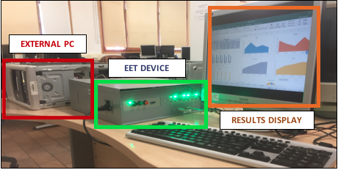
FEETINGS

Slide 44
FEETINGS
We have used EET to measure:
Ordering algorithms (basically to validate the device)
PHR (Personal Health Records)
Data compression algorithms
Hadoop
Redmine
Social Networks
Web search
Notes:
Ordering algorithms (basically to validate the device). PHR (Personal Health Records) to classify them according to the energy consumption. We are doing this work with our colleagues from Murcia and they have the complete results.
Data compression algorithms. We are just starting this line of research with people from A Coruña. The objective is to know the relationship between the level of data compression and the energy savings.
Hadoop. We have selected different versions of Hadoop and we have compared, on one hand the results of the energy consumption when using it and, on the other hand, its size, complexity and maintainability (obtained from SonarCloud tool), in order to study if there is some kind of correlation between each quality characteristic and the energy consumption through versions.
Redmine. Same procedure than with Hadoop. We have finished the measurements and we have the results interpreted.
Usage of social networks (twitter, facebook). We are comparing the energy needed when posting a tweet or an entry on facebook depending on the amount of information (text, text and images, video, etc). We are staritng the measurements.
Web search. We are comparing the energy usage when looking for a photo on several browsers. The idea is to extend the study to other kind of searches trying to classify the browsers depending on their consumption

Slide 45
SOS (Software Sustainability)
Notes:
In this section, Fig. 7 will be used as a basis to show a snapshot of what the software sustainability measurement currently looks like. As an example, we shall present some measures and/or indicators defined for each of the levels shown in Fig. 7 (when possible). In some cases, we shall also provide some useful references that include revisions of the literature and can be used as a good point of start.

Slide 46
SOS
We are working on the three dimensions of Software Sustainability;
CSR (Corporate Social Responsibility) and Software Sustainability in industries

Slide 47

Conclusions and Future work

Slide 48
Conclusions and Future work
Green and sustainable software is a highly active area of research;
Green and sustainable software has achieved a good level of maturity and is a stable line of research
The most frequently used keywords are: Green Software, Green IT, Sustainability, Software Sustainability, Sustainable Software, Energy Consumption, Energy Efficiency
More than a half of the keywords are related to a SWEBOK area. There are four SWEBOK areas without contributions.

Slide 49
Conclusions and Future work
Industry is on other level of maturity
Only one company has over 50% of their CSR actions dedicated to sustainability aspects and one has no actions
The dimension with the biggest number of actions is the HUMAN dimension. The one with lesser number of actions is the ENVIRONMENTAL dimension

Slide 50


Slide 51



Sostenibilidad Software: ¿realidad o quimera?
Coral Calero
Coral.Calero@uclm.es

